Slide 1
Lecture 6
Chemically reacting flows
Part 1

Slide 2
General concepts
Multicomponent gas mixture in which chemical reactions occur
Examples:
combustion,
chemical synthesis,
heterogeneous catalysis,
atmospheric chemistry,
materials processing.
processes in aircraft engines

Slide 3
Main parameters characterizing a gas mixture
temperature T
pressure p
volume V
mass m_{s} of the component s
number of moles n_{s}= m_{s} / M_{s} , ( M_{s} - molar mass)

Slide 5
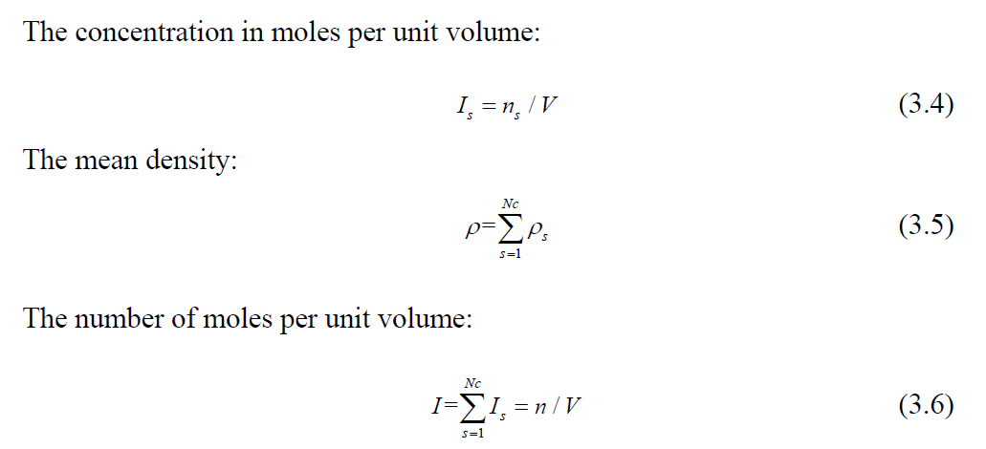

Slide 7
Species mass conservation equation
The equation of mass conservation of the component s is derived similarly to the general continuity equation

Slide 10
The diffusion flux of each component of the gas mixture can be assumed to be proportional to the gradients of the mass fractions (Fick's law):

Slide 11
The energy equation for chemically reacting gas mixture.
The specific enthalpy of the component s. It consists of chemical and thermal parts:

Slide 12
Standard enthalpy of formation
The standard enthalpy of formation or standard heat of formation of a compound is the change of enthalpy during the formation of 1 mole (or 1 kg) of the substance from its constituent elements, with all substances in their standard states.

Slide 14
The heat flux density is composed of transport due to thermal conductivity and diffusion:

Slide 15
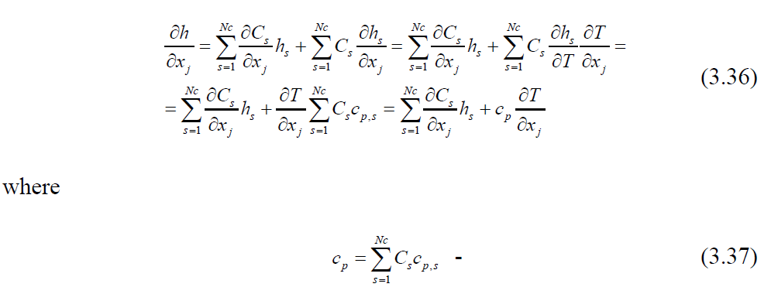

Slide 17
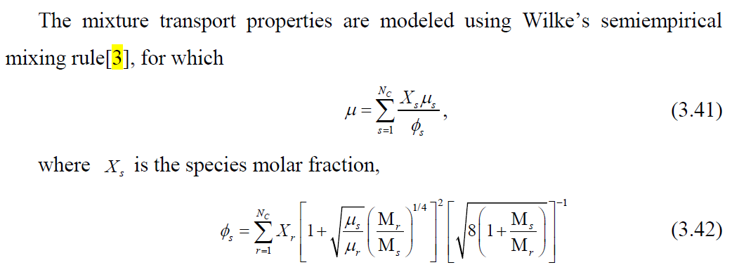
The transport properties of a gas mixture

Slide 18
The kinetics of chemical reactions

